Slide 1



AcF 304 Financial Markets
Topic 6: The Money Markets
Part 5 – Summary & Next Week’s Preview
Notes:
If this PowerPoint presentation contains mathematical equations, you may need to check that your computer has the following installed:
1) MathType Plugin
2) Math Player (free versions available)
3) NVDA Reader (free versions available)

Slide 2
Topic Summary (1 of 4)
The Money Markets Defined
Short-term instruments
Most have a low default probability
The Purpose of Money Markets
Used to “warehouse” funds
Returns are low because of low risk and high liquidity

Slide 3
Topic Summary (2 of 4)
Who Participates in Money Markets?
U.S. Treasury
Commercial banks
Businesses
Individuals (through mutual funds)
Money Market Instruments
Include T-bills, fed funds, etc.

Slide 4
Topic Summary (3 of 4)
Comparing Money Market Securities
Issuers range from the US government to banks to large corporations
Mature in as little as 1 day to as long as 1 year
The secondary market liquidity varies substantially

Slide 5
Topic Summary (4 of 4)
Money Market in Practise
Trading Deposits
LIBOR

Slide 6
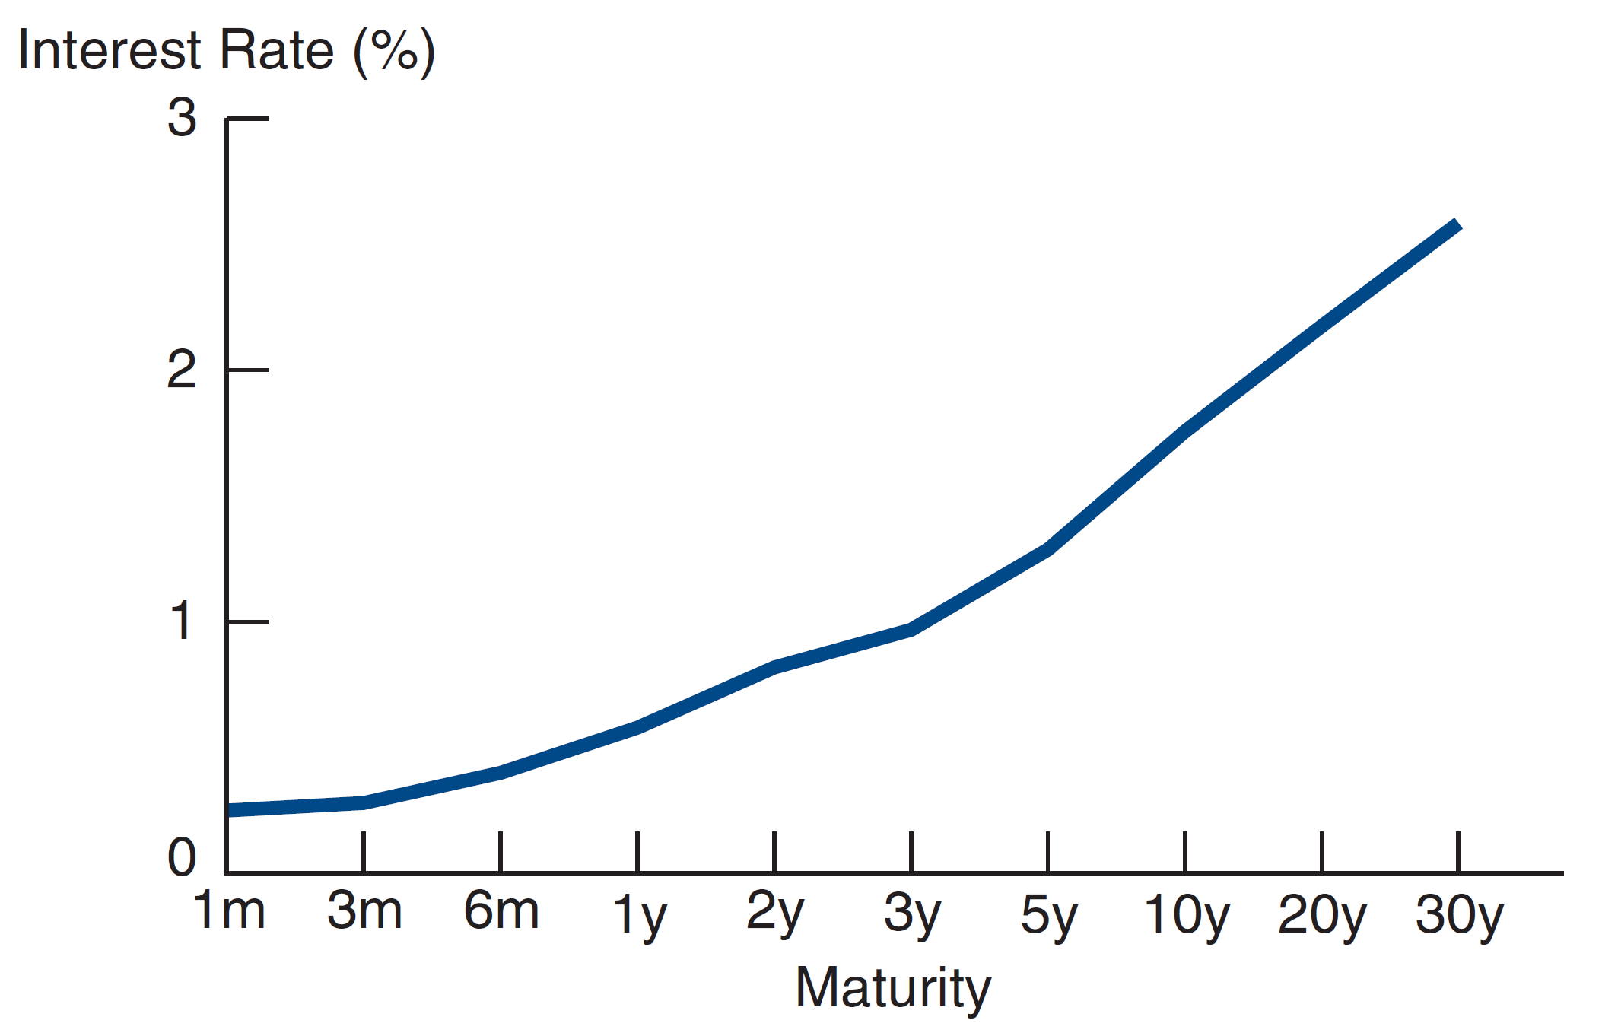
Following the News: The Yield Curve

Slide 7
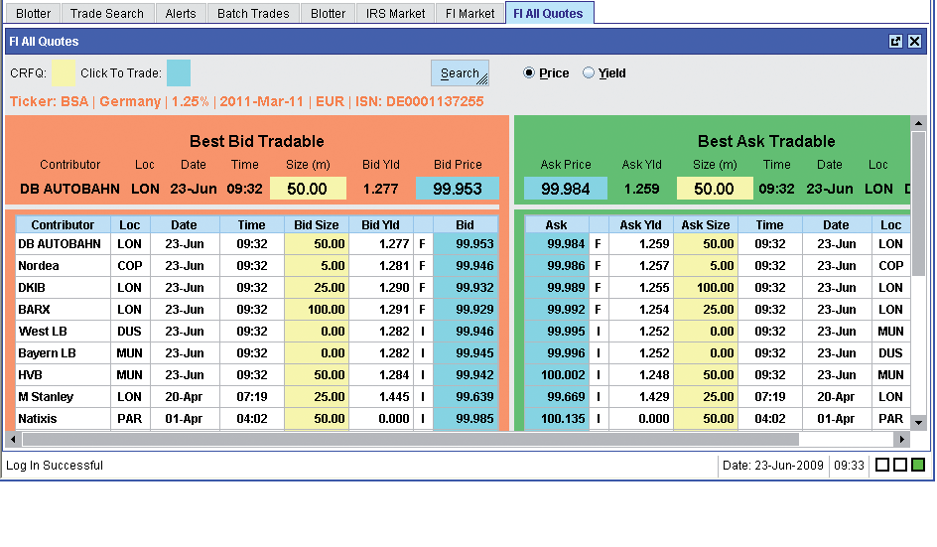
Liquidity Risk
Dealer Bid/Offer Spreads

